Slide 1
Research on Fine-grained S&T Entity Identification with Contextual Semantics in Think-Tank Text
Mengge Sun, Yanpeng Wang*, Yang Zhao
1. National Science Library, Chinese Academy of science
2. Department of Information Resources Management, School of Economics and Management, University of Chinese Academy of Sciences
Notes:
做的东西与老师的契合度！！

Slide 2
Motivation
Scientific Papers
Think Tank Report
Policy Document
Knowledge flow path
Content flowed
Fine-grained S&T Entity with Contextual Semantics
The role of think tank documents in the path of knowledge flow is “knowledge intermediary”
The automatic extraction of scientific and technological entities mentioned in think tank reports can further clarify policy and public concerns efficiently.

Slide 3
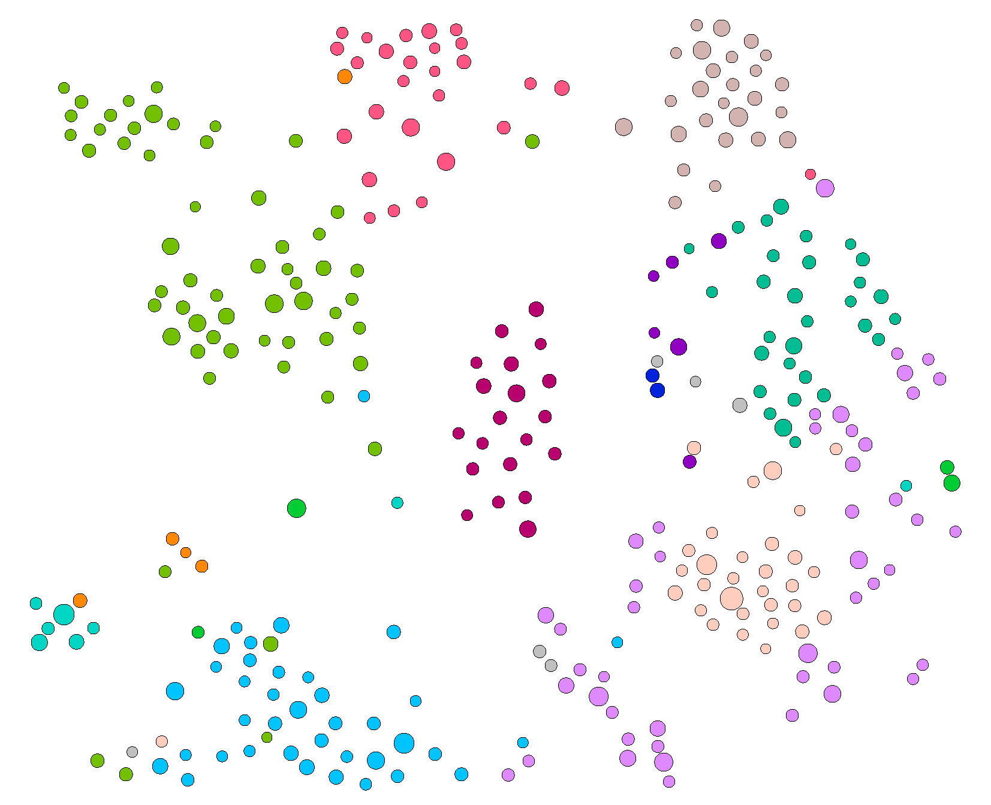
Fine-grained S&T Entity with Contextual Semantics
Three levels of granularity of scientific research are represented in the form of a graph:
Micro: Each node represents a specific research point
Middle: The same color nodes compose the research direction or problem with application scenarios, technical solutions, technical routes.
Macro: All nodes make up the frontier research topic.
A quantum algorithm for solving linear equations by using superconducting quantum circuits
(micro)
Quantum computer technology based on light and superconducting systems
(Middle)
Quantum information technology
(macro)

Slide 4
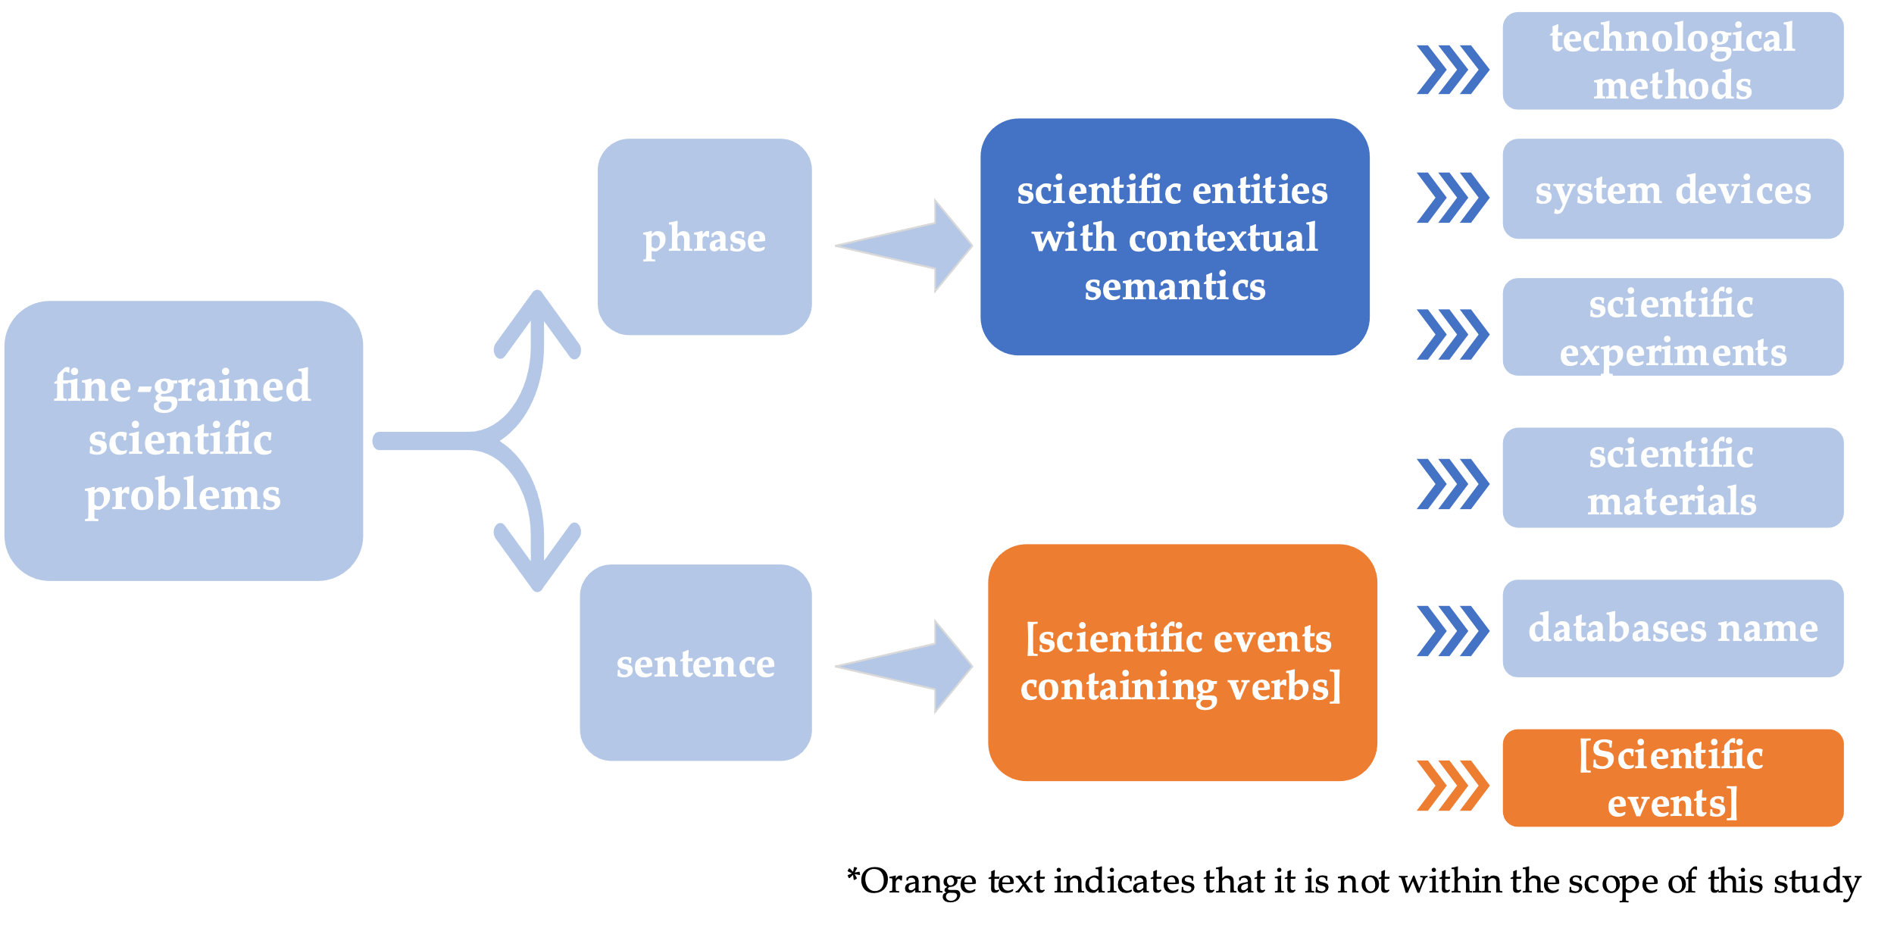
Conceptual analysis of fine-grained S&T problem
Depending on the type of scientific solution sought, they can be distinguished into technological methods, system devices, scientific experiments, scientific materials, and databases name.

Slide 5
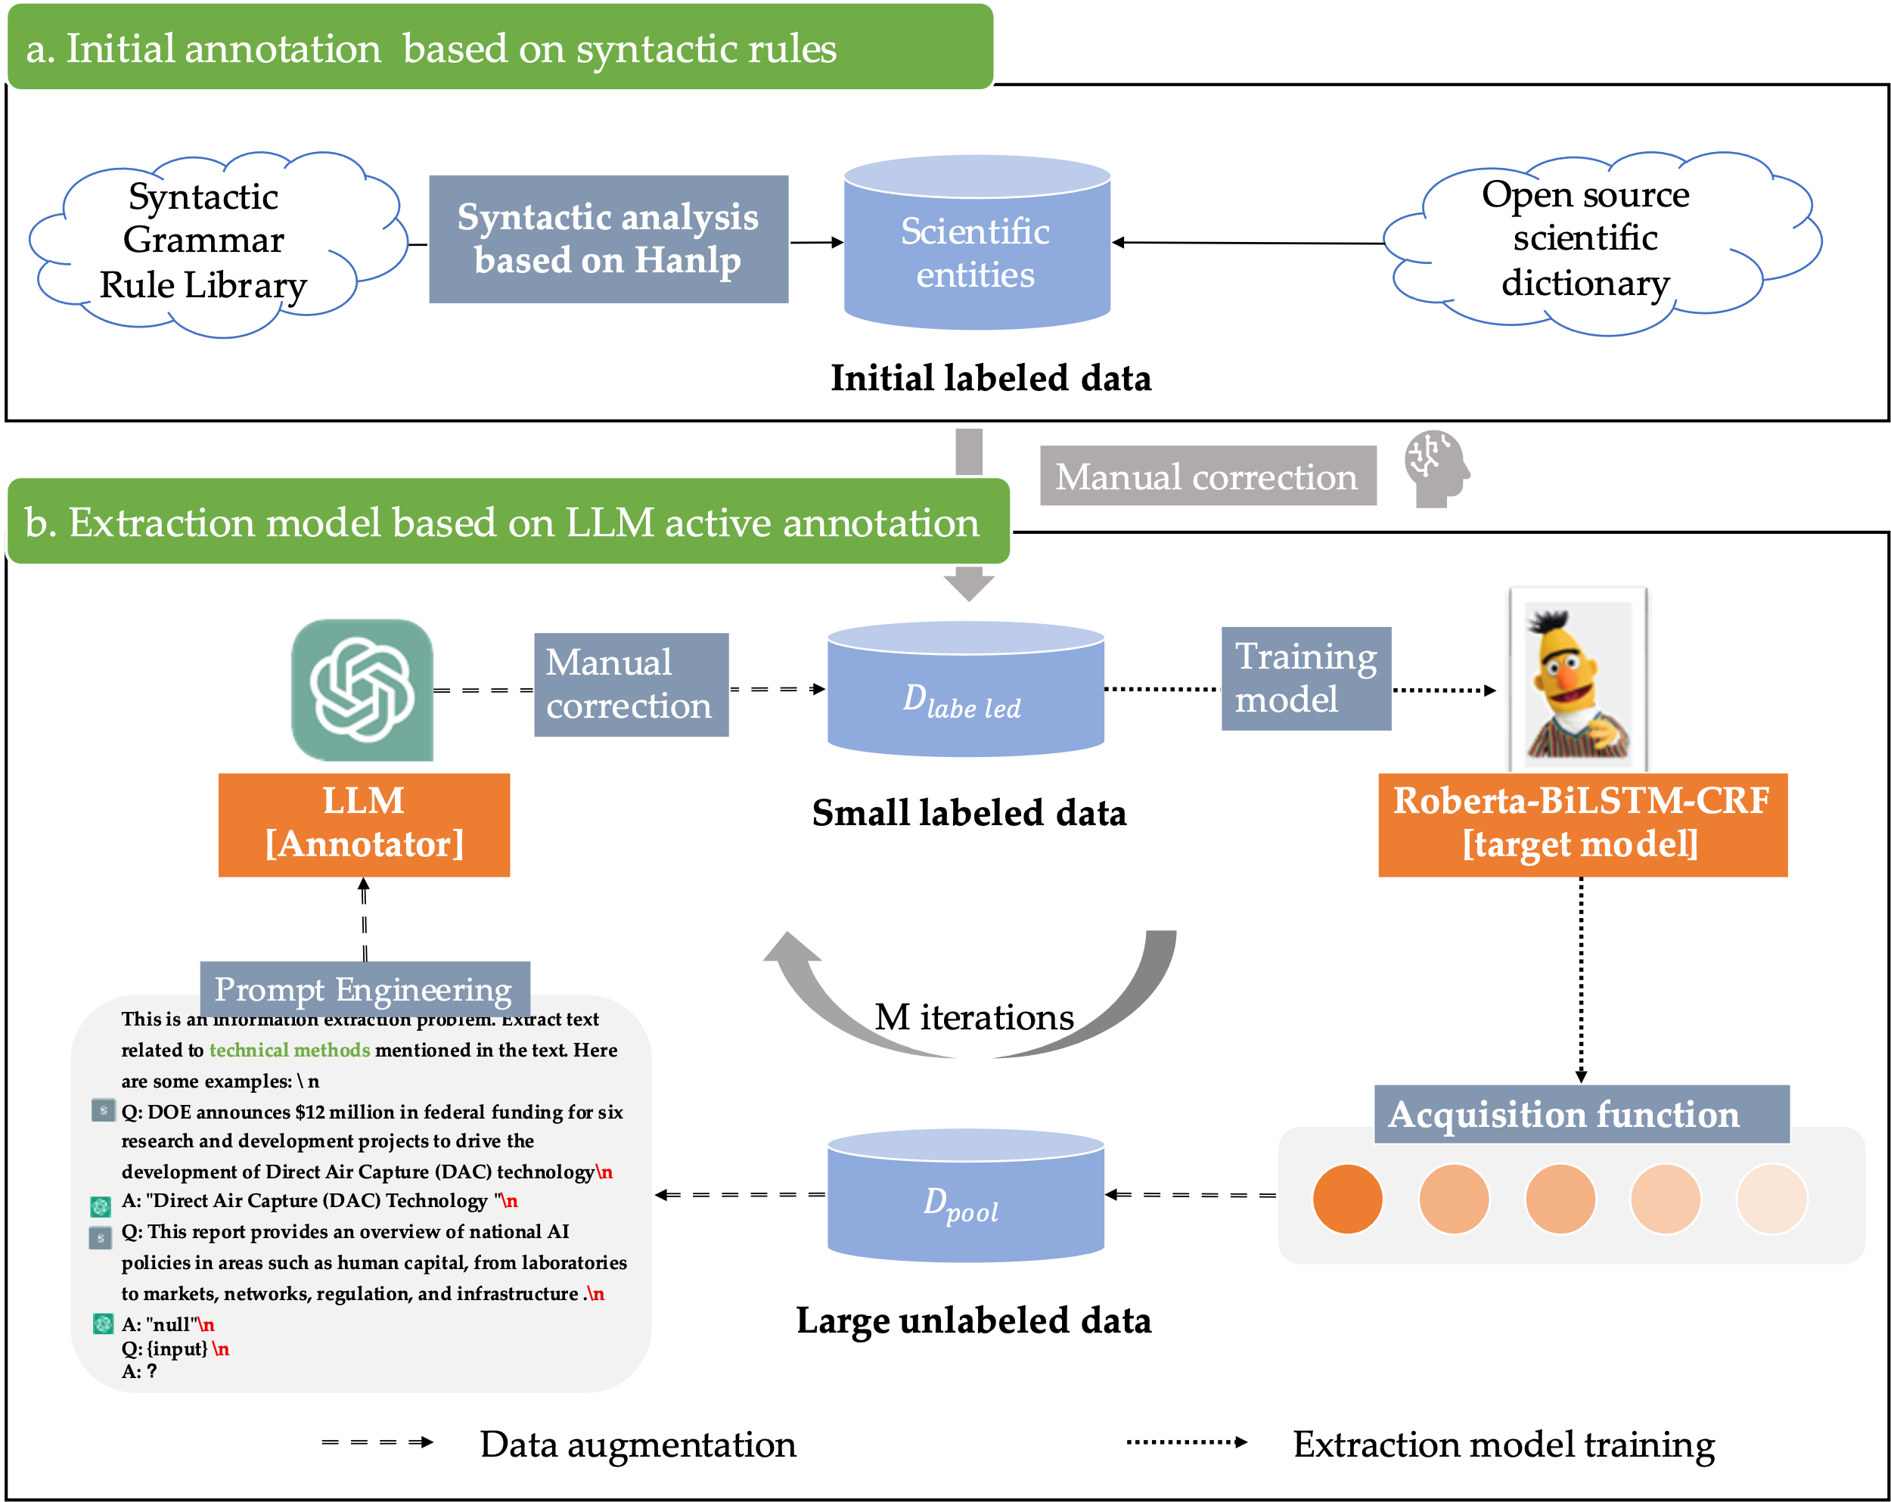
Research Framework

Slide 6
Initial annotation based on syntactic rules
Cold Start
Examples of lexical and syntactic rules
Guide words | Syntax rules
exploit promote propel focus on support set up realize support strengthen facilitate | improve.*by.*? push.*by.*? strengthen.*by.*? understand.*by.*? prepare.*by.*? based on.*? . *? for.* use.*? to develop.* solve.*? aim to.*? the key question is.*? research direction is.*? fund.*? push.*?

Slide 7
Extraction model based on LLM active annotation
In this part, the main goal is to gradually fine-screen small-scale annotated data from a large amount of unlabeled data, while using a large language model as the annotation model.
At the same time, a S&T entity extraction model called "Roberta-BiLSTM-CRF" is trained. The entire process is carried out in m iterations.

Slide 8
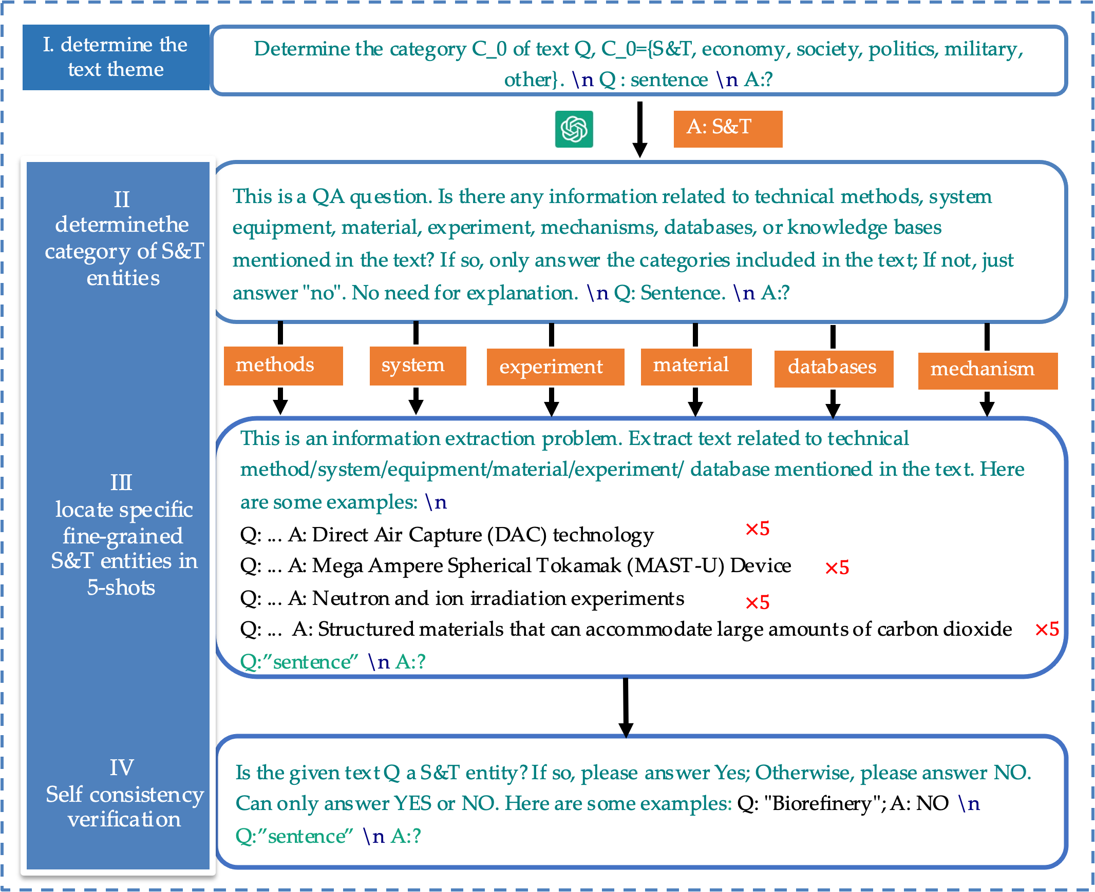
Extraction model based on LLM active annotation
Optimizing LLM as a Better Annotator
Guided by the Chain-of-Thought(CoT) approach, this article transforms this task into a multi-round Q&A question, enabling the GPT model to gradually locate the fine-grained categories of S&T entities contained in the text through conversation, and finally annotate them.

Slide 9
Extraction model based on LLM active annotation
Active data acquisition
Active acquisition strategies generally maximize either uncertainty or diversity. On one hand, uncertainty-based methods leverage model predictions to select hard examples. On the other hand, diversity-based methods exploit the heterogeneity of sampled data.
(1) Maximum Entropy. Entropy is one of the most widely used estimations of uncertainty. Data for which model M has the highest entropy are sampled for annotation according to
${argmax}_{x∈D_{pool}}−\sum_{y∈Y}{P_{M}(y|x)logP_{M}(y|x)}$.
(2) Least Confidence. (Culotta and McCallum 2005) proposes to sort examples with the probability assigned by M to predicted class $\hat{y}$, which samples
${argmax}_{x∈D_{pool}}\left(1− P_{M}\left(\hat{y} | x\right)\right)$.

Slide 10
Research Dataset
We have collected data sources such as frontier research, policy, and consultation bulletins released by various research institutes, which can complement each other to a certain extent and comprehensively reflect the key science development progress concerned by various countries.
Frontier research bulletins
Policy bulletins
Consultation bulletins

Slide 11
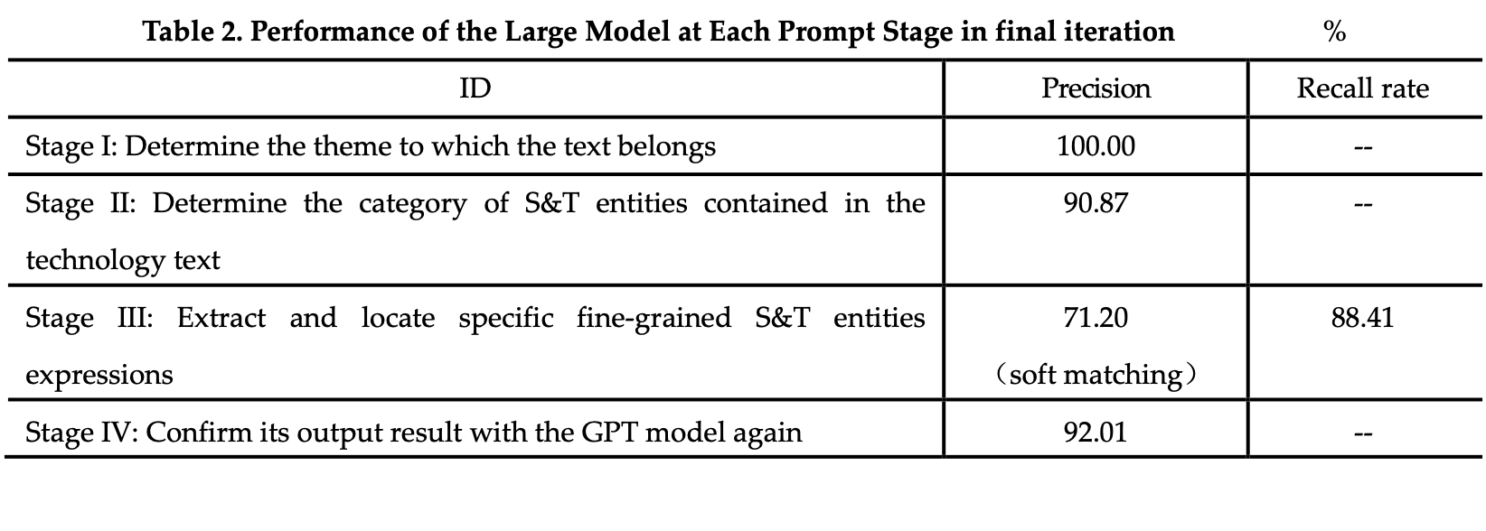
Experiments Results
The identification effect based on different LLM and prompt
The 5-shot prompt performs better because combining multiple random examples can reduce the impact of noise.

Slide 12
Experiments Results
Analysis of Model extraction effect
The model achieved an F1 value of 86.02% in our task, the effectiveness and reliability of the model were verified by comparing it with the benchmark model through experiments.

Slide 13
Thanks for listening

